Slide 1
MAC protocols

Slide 2
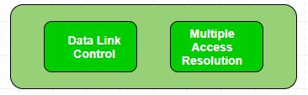
Multiple Access Protocols
The Data Link Layer is responsible for transmission of data between two nodes. Its main functions are-
Data Link Control
Multiple Access Control
Data Link control –
The data link control is responsible for reliable transmission of message over transmission channel by using techniques like framing, error control and flow control. For Data link control refer to – Stop and Wait ARQ
Multiple Access Control –
If there is a dedicated link between the sender and the receiver then data link control layer is sufficient, however if there is no dedicated link present then multiple stations can access the channel simultaneously. Hence multiple access protocols are required to decrease collision and avoid crosstalk. For example, in a classroom full of students, when a teacher asks a question and all the students (or stations) start answering simultaneously (send data at same time) then a lot of chaos is created( data overlap or data lost) then it is the job of the teacher (multiple access protocols) to manage the students and make them answer one at a time.
Thus, protocols are required for sharing data on non dedicated channels. Multiple access protocols can be subdivided further as –

Slide 3
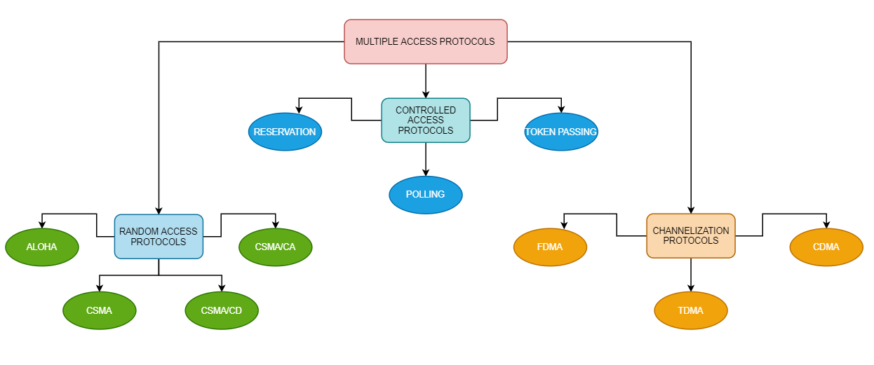

Slide 4
1. Random Access Protocol: In this, all stations have same superiority that is no station has more priority than another station. Any station can send data depending on medium’s state( idle or busy). It has two features:
There is no fixed time for sending data
There is no fixed sequence of stations sending data
ALOHA Random Access Protocol
It is designed for wireless LAN (Local Area Network) but can also be used in a shared medium to transmit data. Using this method, any station can transmit data across a network simultaneously when a data frameset is available for transmission.
Aloha Rules
Any station can transmit data to a channel at any time.
It does not require any carrier sensing.
Collision and data frames may be lost during the transmission of data through multiple stations.
Acknowledgment of the frames exists in Aloha. Hence, there is no collision detection.
It requires retransmission of data after some random amount of time.

Slide 5
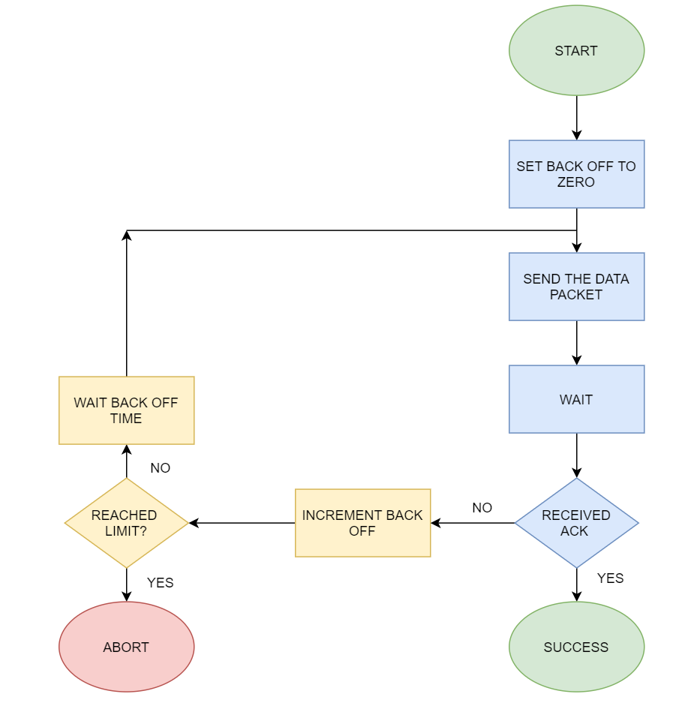

Slide 6
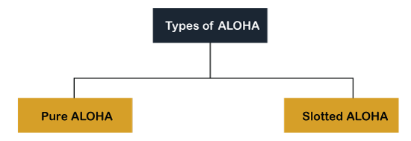
Pure Aloha
Whenever data is available for sending over a channel at stations, we use Pure Aloha. In pure Aloha, when each station transmits data to a channel without checking whether the channel is idle or not, the chances of collision may occur, and the data frame can be lost. When any station transmits the data frame to a channel, the pure Aloha waits for the receiver's acknowledgment. If it does not acknowledge the receiver end within the specified time, the station waits for a random amount of time, called the backoff time (Tb). And the station may assume the frame has been lost or destroyed. Therefore, it retransmits the frame until all the data are successfully transmitted to the receiver.
The total vulnerable time of pure Aloha is 2 * Tfr.
Maximum throughput occurs when G = 1/ 2 that is 18.4%.
Successful transmission of data frame is S = G * e ^ - 2 G.

Slide 7
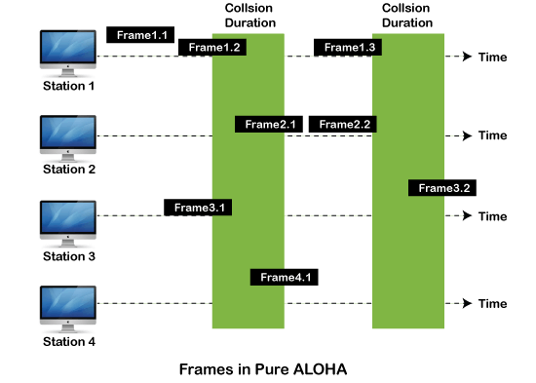
As we can see in the figure above, there are four stations for accessing a shared channel and transmitting data frames. Some frames collide because most stations send their frames at the same time. Only two frames, frame 1.1 and frame 2.2, are successfully transmitted to the receiver end. At the same time, other frames are lost or destroyed. Whenever two frames fall on a shared channel simultaneously, collisions can occur, and both will suffer damage. If the new frame's first bit enters the channel before finishing the last bit of the second frame. Both frames are completely finished, and both stations must retransmit the data frame.

Slide 8
Slotted Aloha
The slotted Aloha is designed to overcome the pure Aloha's efficiency because pure Aloha has a very high possibility of frame hitting. In slotted Aloha, the shared channel is divided into a fixed time interval called slots. So that, if a station wants to send a frame to a shared channel, the frame can only be sent at the beginning of the slot, and only one frame is allowed to be sent to each slot. And if the stations are unable to send data to the beginning of the slot, the station will have to wait until the beginning of the slot for the next time. However, the possibility of a collision remains when trying to send a frame at the beginning of two or more station time slot.
Maximum throughput occurs in the slotted Aloha when G = 1 that is 37%.
The probability of successfully transmitting the data frame in the slotted Aloha is S = G * e ^ - 2 G.
The total vulnerable time required in slotted Aloha is Tfr.

Slide 9
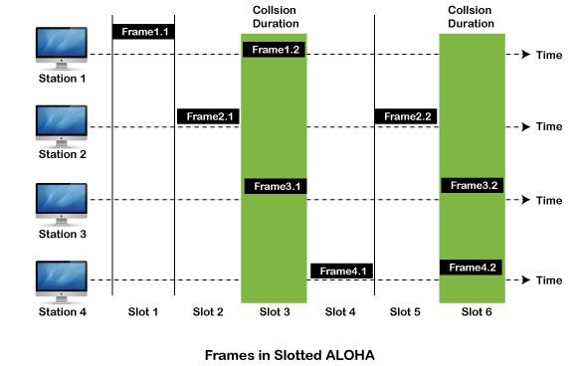

Slide 10
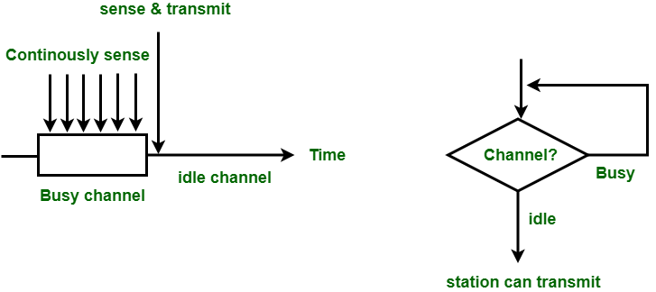
CSMA (Carrier Sense Multiple Access)
It is a carrier sense multiple access based on media access protocol to sense the traffic on a channel (idle or busy) before transmitting the data. It means that if the channel is idle, the station can send data to the channel. Otherwise, it must wait until the channel becomes idle. Hence, it reduces the chances of a collision on a transmission medium.
CSMA Access Modes
1-Persistent: In 1-persistent CSMA, the station continuously senses the channel to check its state i.e. idle or busy so that it can transfer data or not. In case when the channel is busy, the station will wait for the channel to become idle. When station found idle channel, it transmits the frame to the channel without any delay. It transmits the frame with probability 1. Due to probability 1, it is called 1-persistent CSMA.
The problem with this method is that there are a large number of chances for the collision it is because there is a chance when two or more stations found channel in idle state and the transmit frames at the same time. On the time when collision occurs the station has to wait for the random time for the channel to be idle and to start all again.

Slide 11
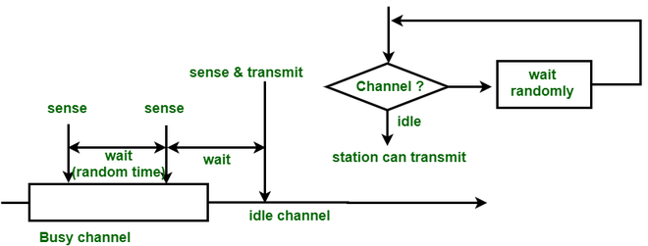
Non-Persistent: In this method, the station that has frames to send, only that station senses for the channel. In case of an idle channel, it will send frame immediately to that channel. In case when the channel is found busy, it will wait for the random time and again sense for the state of the station whether idle or busy. In this method, the station does not immediately sense for the channel for only the purpose of capturing it when it detects the end of the previous transmission. The main advantage of using this method is that it reduces the chances of collision. The problem with this is that it reduces the efficiency of the network.
P-Persistent: This is the method that is used when channel has time-slots and that time-slot duration is equal to or greater than the maximum propagation delay time. When the station is ready to send the frames, it will sense the channel. If the channel found to be busy, the channel will wait for the next slot. If the channel found to be idle, it transmits the frame with probability p, thus for the left probability i.e. q which is equal to 1-p the station will wait for the beginning of the next time slot. In case, when the next slot is also found idle it will transmit or wait again with the probabilities p and q. This process is repeated until either the frame gets transmitted or another station has started transmitting.

Slide 12
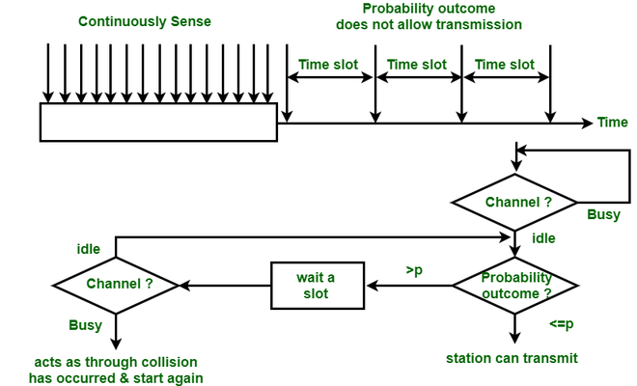

Slide 13
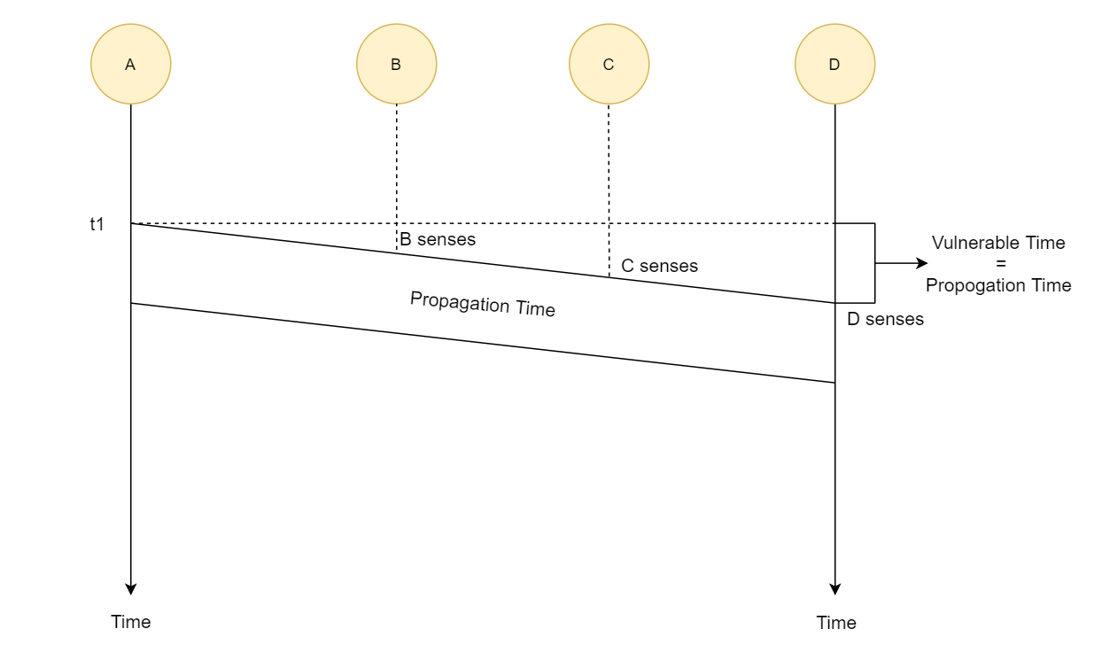
Throughput & Efficiency of CSMA:
It is comparatively much greater than the throughput of pure and slotted ALOHA. Here, for the 1-persistent mode, the throughput is 50% when G=1 and for Non-persistent mode, the throughput can reach up to 90%.

Slide 14
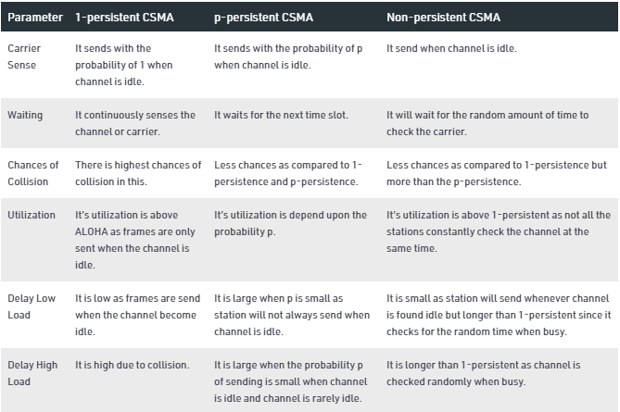
Difference between 1-Persistent,P-Persistent and Non-persistent CSMA

Slide 15
CSMA/ CD
It is a carrier sense multiple access/ collision detection network protocol to transmit data frames. The CSMA/CD protocol works with a medium access control layer. Therefore, it first senses the shared channel before broadcasting the frames, and if the channel is idle, it transmits a frame to check whether the transmission was successful. If the frame is successfully received, the station sends another frame. If any collision is detected in the CSMA/CD, the station sends a jam/ stop signal to the shared channel to terminate data transmission. After that, it waits for a random time before sending a frame to a channel.
CSMA/ CA
It is a carrier sense multiple access/collision avoidance network protocol for carrier transmission of data frames. It is a protocol that works with a medium access control layer. When a data frame is sent to a channel, it receives an acknowledgment to check whether the channel is clear. If the station receives only a single (own) acknowledgments, that means the data frame has been successfully transmitted to the receiver. But if it gets two signals (its own and one more in which the collision of frames), a collision of the frame occurs in the shared channel. Detects the collision of the frame when a sender receives an acknowledgment signal.
These are three types of strategies:
InterFrame Space (IFS) – When a station finds the channel busy, it waits for a period of time called IFS time. IFS can also be used to define the priority of a station or a frame. Higher the IFS lower is the priority.

Slide 16
Contention Window – It is the amount of time divided into slots. A station which is ready to send frames chooses random number of slots as wait time.
Acknowledgements – The positive acknowledgements and time-out timer can help guarantee a successful transmission of the frame.

Slide 17
Controlled Access Protocol
It is a method of reducing data frame collision on a shared channel. In the controlled access method, each station interacts and decides to send a data frame by a particular station approved by all other stations. It means that a single station cannot send the data frames unless all other stations are not approved. It has three types of controlled access:
Reservation
Polling
Token Passing
Reservation
In the reservation method, a station needs to make a reservation before sending data.
The time line has two kinds of periods:
Reservation interval of fixed time length
Data transmission period of variable frames.
If there are M stations, the reservation interval is divided into M slots, and each station has one slot.
Suppose if station 1 has a frame to send, it transmits 1 bit during the slot 1. No other station is allowed to transmit during this slot.
In general, i th station may announce that it has a frame to send by inserting a 1 bit into i th slot. After all N slots have been checked, each station knows which stations wish to transmit.
The stations which have reserved their slots transfer their frames in that order.
After data transmission period, next reservation interval begins.
Since everyone agrees on who goes next, there will never be any collisions.

Slide 18
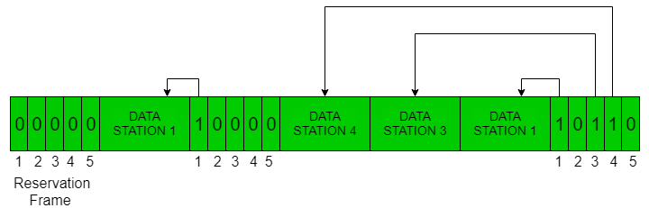
The following figure shows a situation with five stations and a five slot reservation frame. In the first interval, only stations 1, 3, and 4 have made reservations. In the second interval, only station 1 has made a reservation.

Slide 19
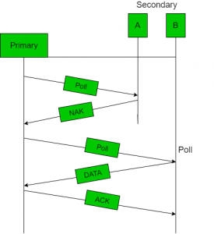
Polling
Polling process is similar to the roll-call performed in class. Just like the teacher, a controller sends a message to each node in turn.
In this, one acts as a primary station(controller) and the others are secondary stations. All data exchanges must be made through the controller.
The message sent by the controller contains the address of the node being selected for granting access.
Although all nodes receive the message but the addressed one responds to it and sends data, if any. If there is no data, usually a “poll reject”(NAK) message is sent back.
Problems include high overhead of the polling messages and high dependence on the reliability of the controller.

Slide 20
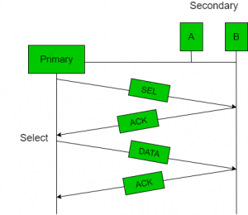
Efficiency Let T_{poll} be the time for polling and T_{t} be the time required for transmission of data. Then,
Efficiency = T_{t}/(T_{t} + T_{poll})

Slide 21
Token Passing
In token passing scheme, the stations are connected logically to each other in form of ring and access of stations is governed by tokens.
A token is a special bit pattern or a small message, which circulate from one station to the next in the some predefined order.
In Token ring, token is passed from one station to another adjacent station in the ring whereas incase of Token bus, each station uses the bus to send the token to the next station in some predefined order.
In both cases, token represents permission to send. If a station has a frame queued for transmission when it receives the token, it can send that frame before it passes the token to the next station. If it has no queued frame, it passes the token simply.
After sending a frame, each station must wait for all N stations (including itself) to send the token to their neighbors and the other N – 1 stations to send a frame, if they have one.
There exists problems like duplication of token or token is lost or insertion of new station, removal of a station, which need be tackled for correct and reliable operation of this scheme.

Slide 22
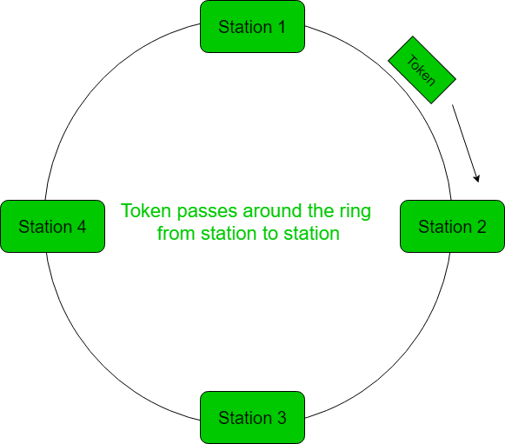

Slide 23
Performance
Performance of token ring can be concluded by 2 parameters:-
Delay, which is a measure of time between when a packet is ready and when it is delivered. So, the average time (delay) required to send a token to the next station = a/N.
Throughput, which is a measure of the successful traffic.
Throughput, S = 1/(1 + a/N) for a<1
and
S = 1/{a(1 + 1/N)} for a>1. where N = number of stations a = T_{p}/T_{t} (T_{p} = propagation delay and T_{t} = transmission delay)

Slide 24
Channelization Protocols
It is a channelization protocol that allows the total usable bandwidth in a shared channel to be shared across multiple stations based on their time, distance and codes. It can access all the stations at the same time to send the data frames to the channel.
Following are the various methods to access the channel based on their time, distance and codes:
FDMA (Frequency Division Multiple Access)
TDMA (Time Division Multiple Access)
CDMA (Code Division Multiple Access)
FDMA
In frequency-division multiple access (FDMA), the available bandwidth is divided into frequency bands. Each station is allocated a band to send its data.
In other words, each band is reserved for a specific station, and it belongs to the station all the time. Each station also uses a bandpass filter to confine the transmitter frequencies.
To prevent station interferences, the allocated bands are separated from one another by small guard bands. The following figure shows the idea of FDMA.

Slide 25
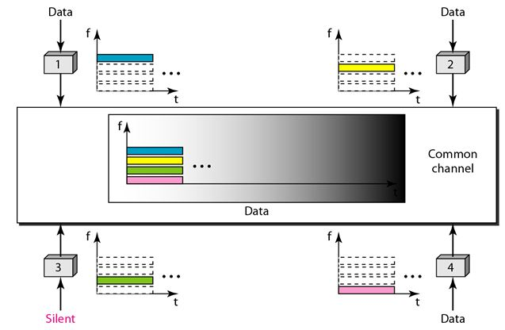

Slide 26
TDMA
In time-division multiple access (TDMA), the stations share the bandwidth of the channel in time. Each station is allocated a time slot during which it can send data. Each station transmits its data in its assigned time slot. The following figure shows the idea behind TDMA.
The main problem with TDMA lies in achieving synchronization between the different stations. Each station needs to know the beginning of its slot and the location of its slot.
This may be difficult because of propagation delays introduced in the system if the stations are spread over a large area. To compensate for the delays, we can insert guard times.
Synchronization is normally accomplished by having some synchronization bits at the beginning of each slot.
CDMA
CDMA simply means communication with different codes. CDMA differs from FDMA because only one channel occupies the entire bandwidth of the link. It differs from TDMA because all stations can send data simultaneously; there is no timesharing.
Implementation:
Let us assume we have four stations 1, 2, 3, and 4 connected to the same channel. The data from station 1 are d1 , from station 2 are d2, and so on. The code assigned to the first station is c1, to the second is c2, and so on. We assume that the assigned codes have two properties.
1. If we multiply each code by another, we get 0.
2. If we multiply each code by itself, we get 4 (the number of stations).

Slide 27
With these two properties in mind, how the above four stations can send data using the same common channel, as shown in the following figure.
Station 1 multiplies (a special kind of multiplication, as we will see) its data by its code to get d1.c1. Station 2 multiplies its data by its code to get d2.c2. And so on. The data that go on the channel are the sum of all these terms, as shown in the box.
Any station that wants to receive data from one of the other three multiplies the data on the channel by the code of the sender. For example, suppose stations 1 and 2 are talking to each other. Station 2 wants to hear what station 1 is saying. It multiplies the data on the channel by c1 the code of station1. Because (c1.c1) is 4, but (c2 . c1), (c3. c1), and (c4 .c1) are all 0s, station 2 divides the result by 4 to get the data from station1.
data =(d1.c1+d2.c2+d3.c3+d4.c4).c1
= c1. d1. c1+ c1. d2. c2+ c1. d3. c3+ c1. d4. c4= 4d1

Slide 28
